Slide 1
Council of the Great City Schools
Task Force Meeting: Black and Latino Young Men and Boys
March 16, 2024

Slide 2
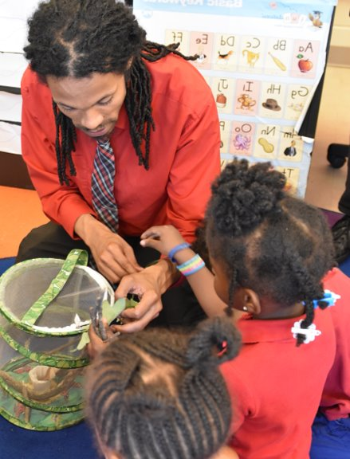
Agenda
Opener
Where We’ve Been
  DCPS Historical Racial Equity Timeline/Journey
Where We Are Now
  Student Data
  EMOC Programming
  MEOCC Programming
  ARE-U Programming
Questions and Discussion

Slide 3
Opener
Please share with your neighbor one transformative experience or individual in your educational journey that led to your success today.

Slide 4
Agenda
Opener
Where We’ve Been
  DCPS Historical Racial Equity Timeline/Journey
Where We Are Now
  Student Data
  EMOC Programming
  MEOCC Programming
  ARE-U Programming
Questions and Discussion

Slide 5
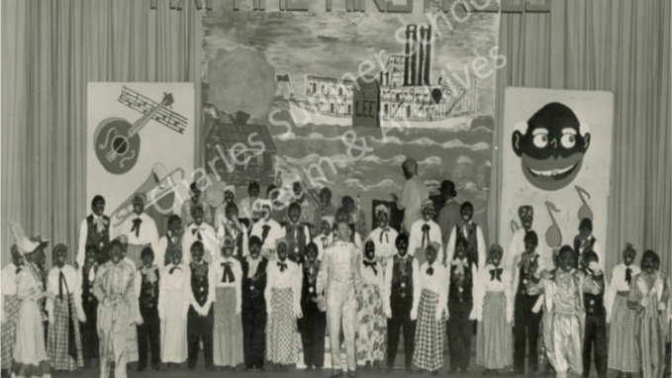
Taft JHS.
Late 1940s.

Slide 6
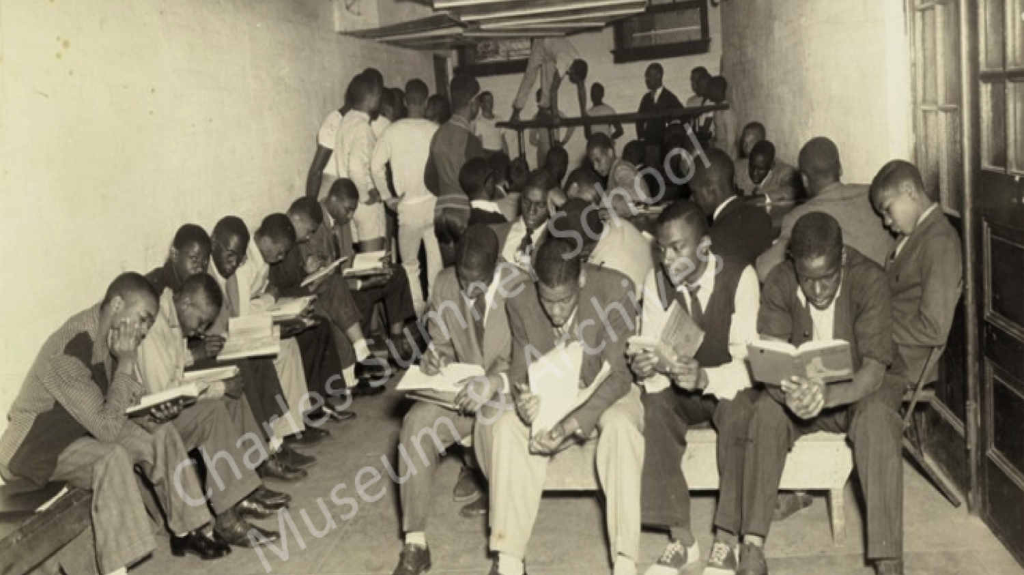
Cardozo SHS.
Late 1940s.
Notes:
Paige - 30 seconds
Cardozo late 1940s
Around this time, many schools had separate classes for boys and girls. The students in this photo are actually in the schools boiler room because the school was overcrowded. There are about 2-3 classes taking place in this space. What appears to be a PE class in the back, a literature class in the foreground, and perhaps another class in the center. Cardozo eventually moved to its current location the Central High School building (white school) in 1950 as Central was under-enrolled and the white students were relocated to other schools.

Slide 7
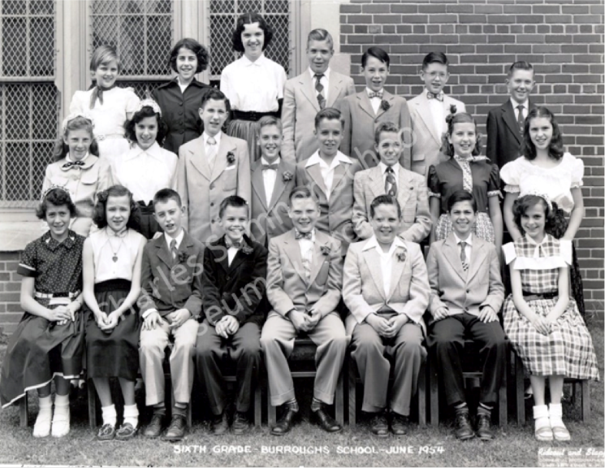
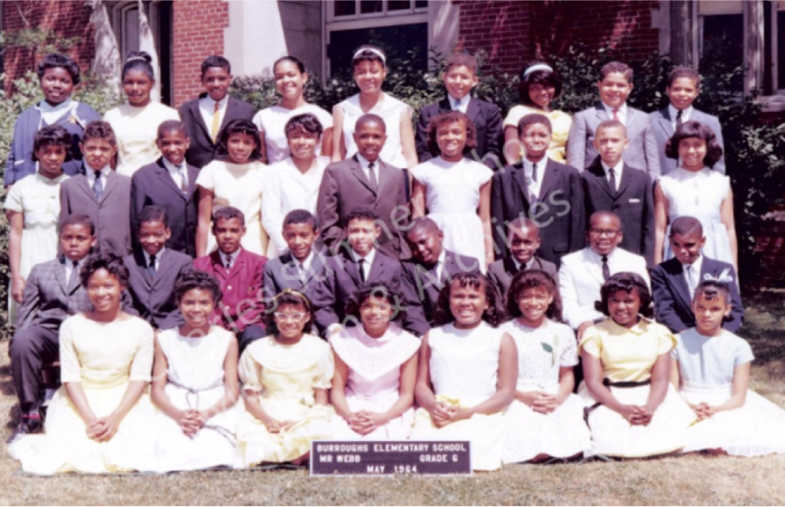
June 1954
May 1964

Slide 8
DCPS Historical Racial Equity Timeline/Journey
2016: Launch of Male Educators of Color Collaborative
2016: DCPS Embraces the PACE Act
2017: Launch of We The Girls
DCPS launched MEOCC as a sustainable cohort of educators in DCPS who create a sense of fellowship and belonging amongst male educators of color within the district, while simultaneously providing them a voice to ensure their needs are heard and met by senior leadership through coordinated advocacy efforts.
To equitably plan for and modernize school facilities, DCPS began using a data-driven methodology based on clear selection criteria for inclusion and prioritization of facilities.
Mayor Bowser and DCPS launched Reign: Empowering Young Women as Leaders, a multi-pronged initiative to support young women of color. This initiative has been launched in middle and high schools.
2015: Launch of Empowering Males of Color at DCPS
2016: Opening of Ron Brown College Preparatory High School
2017: Formation of DCPS Office of Equity
2018: Equity-Focused Summer Leadership Institute
Mayor Bowser and DCPS launched this
initiative to advance achievement and opportunity and reduce racial disparities for boys and men of color across the city. It invested $20M over three years to target the most urgent and persistent challenges.
In response to historically low graduation rates for male students of color, DCPS opened Ron Brown College Preparatory High School, in tandem with President Obama's 'My Brother's Keeper' initiative. It was the only single-sex public high school in D.C. championing restorative justice practices at the time.
In response to the needs articulated in the 2017-2022 Capital Commitment, DCPS formed the Office of Equity to develop an equity vision and strategic plan.
DCPS created and implemented a 3-day Equity-focused Summer Leadership Institute for all school leaders and assistant principals.

Slide 9
DCPS Historical Racial Equity Timeline/Journey
2019: Creation and Release of the Equity Framework
2020: Launch of Protocol to Respond to Incidents of Hate and Bias
2021: DCPS Becoming
2021: IMPACT Equity Report
DCPS launches DCPS Becoming to align and implement actions to become a whole-child centered, anti-racist school district.
DCPS shared an Equity Report detailing disparate outcomes by multiple factors, including race, as part of the multi-year IMPACT Review to improve teacher evaluation policies and experiences. All evaluators engaged in a three-part anti-bias series utilizing a data reflection tool to reflect on their assessment results.
DCPS created and released the Equity Framework – a resource for internal and external stakeholders to understand DCPS' Equity Definition, Equity Lens and Shared Equity Commitments.
Cross-agency work group created a protocol, grounded in school feedback, to align on the agency response when incidents of hate and bias occur.
2020: Launch of Courageous Conversations Protocol & Training
2021: Launch of Anti-Racist Educator University
2021: Launch of BAM and Rites of Passage Programming
ARE-U is a strategic lever for equity that provides DCPS staff with shared learning rooted in anti-racism, including cluster-based PLCs.
DCPS embraced the Courageous Conversations protocol as a starting place to engage in conversations about race. To date, more than 4,000 DCPS staff have been trained in Courageous Conversation methods.
DCPS launched Rites of Passage programming in middle schools to provide spaces for young male-identifying students of color to engage in intentional programming and experiential learning opportunities, so they develop a positive sense of self and deepen their sense of community. 'Becoming A Man' programming consisting of group and individual counseling, mentoring, and post-secondary readiness for DCPS high school males of color.

Slide 10
DCPS Historical Racial Equity Timeline/Journey
2021: Launch of Management Academy
2022: Launch of Updated School Budget Model
DCPS began offering four equity-centered professional development sessions throughout the year for 200+ people managers.
DCPS utilized an updated budget model focused on equity, transparency, and sustainability to allocate resources to schools. Among the features of the updated model are targeted support funds for each student with disabilities and each English Language Learner, as well as additional funds for schools serving the highest percentages of at-risk students.
2021: Launch of Policy Committee &
GARE Framework
2021: Launch of Equity Centered Pipeline Initiative Grant
2022: DCPS Joins Mayor's Office of Racial Equity Action Cohort
DCPS launched the Policy Committee, a high-level group of leaders from throughout the agency tasked with setting policy priorities for DCPS and reviewing ongoing policy development. The committee aims to use the Government Alliance on Race & Equity (GARE) Racial Equity Toolkit to integrate explicit consideration of racial equity when creating and reviewing policy.
DCPS received a Wallace Foundation grant to create a comprehensive, aligned, and sustainable principal pipeline for equity centered leaders in partnership with local universities, OSSE, and community-based organizations.
DCPS received a Wallace Foundation grant to create a comprehensive, aligned, and sustainable principal pipeline for equity centered leaders in partnership with local universities, OSSE, and community-based organizations.

Slide 11
Agenda
Opener
Where We’ve Been
  DCPS Historical Racial Equity Timeline/Journey
Where We Are Now
  Student Data
  EMOC Programming
  MEOCC Programming
  ARE-U Programming
Questions and Discussion

Slide 12
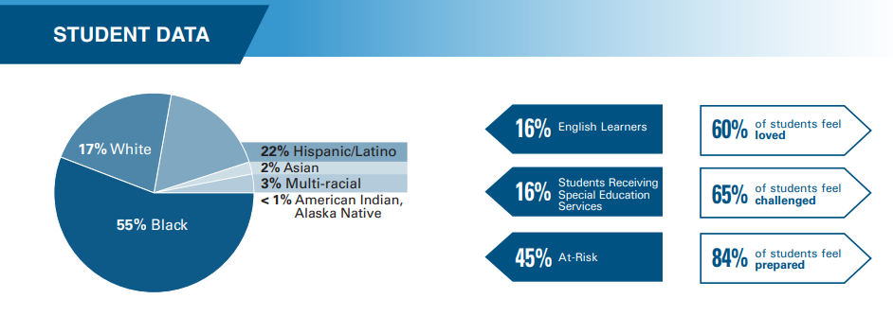
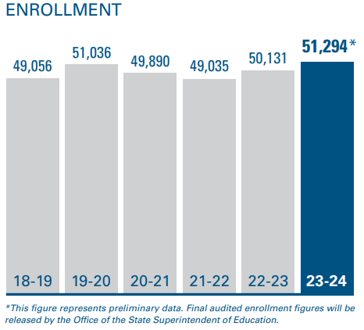
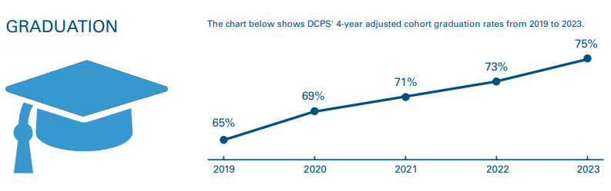
Fast Facts

Slide 13
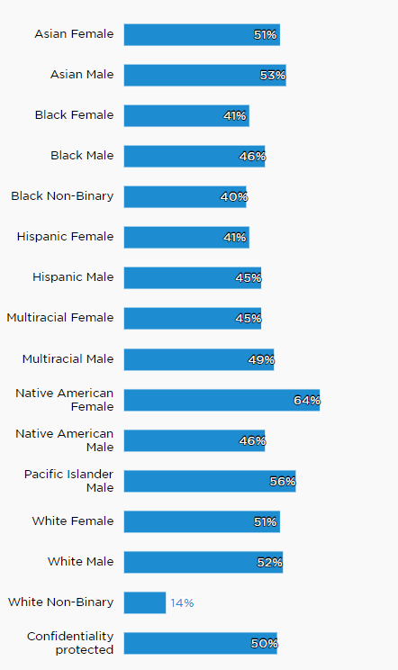
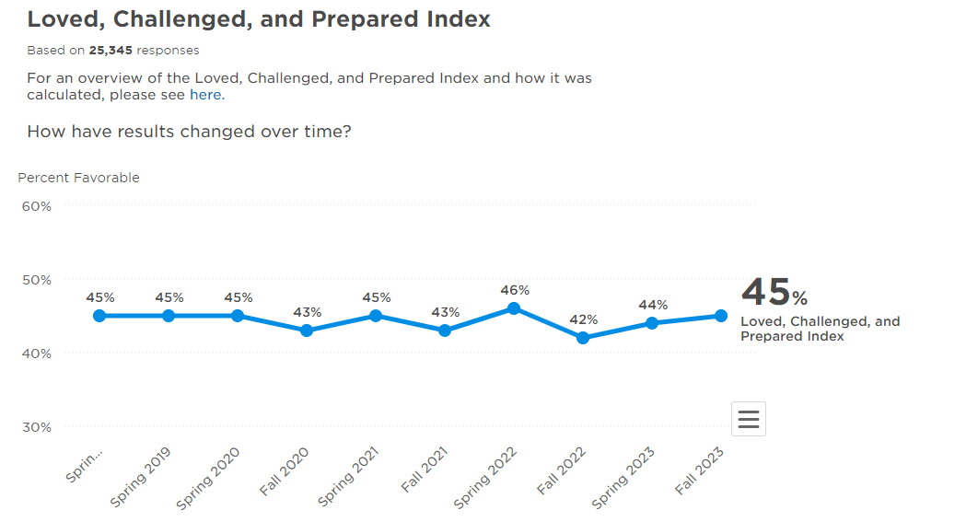
Loved, Challenged, Prepared

Slide 14
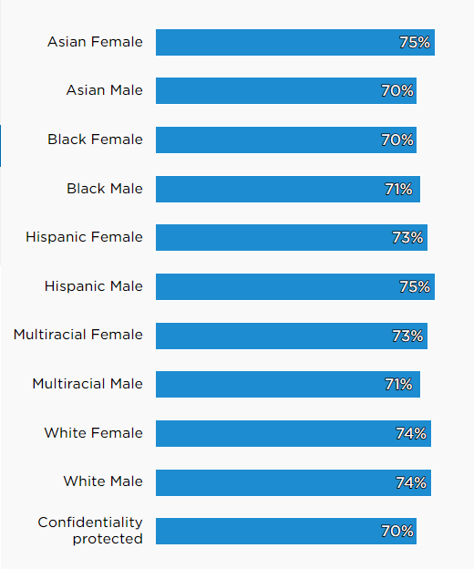
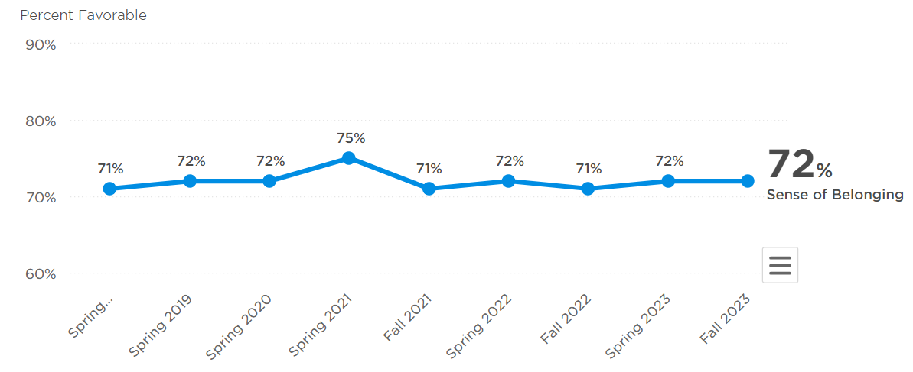
Sense of Belonging
What does this data make you THINK?
What does this data make you FEEL?
What does this data make you WONDER?
Notes:
Compared to all schools in an urban setting, our score is near the 99th percentile on this topic

Slide 15
Student Programming Goals
The Equity Strategy and Programming's student programs promote equity and centering the whole child at DCPS by implementing innovative, student-centered learning experiences designed to position students furthest away from opportunity with the skills and platform to amplify their voices and actively challenge the status quo.
The objectives of these programs are to:
  Sharpen their leadership skills
  Amplify their voice
  Deepen their understanding of self
  Create safe space for students to explore activities that address their social/emotional/mental well-being
This work is implemented through workshops, mentoring, speakers, conferences/engagement opportunities for students, experiential learning and academic enrichment. The program activities help contribute to DCPS goal to ensure 100% of students feel loved, challenged and prepared.

Slide 16
EMOC’s Objectives
Leadership
Identity
Wellness
Community
EMOC engagements provide
opportunities for students to engage with peers, staff, and community leaders to learn more about positive social change leadership and what it means to utilize their voice as students and members of the community.
EMOC provides students with the opportunity to develop positive views of their own identities, to
live authentically and engage in empathy for other individuals and their lived experiences.
Through EMOC, students explore various topics of personal mental, physical, and social-emotional health. Our programs also explore positive relationship building, conflict resolution, and self-care.
We aim to build and enrich member’s view of community; not just in their
schools but of the District.
ROP Chapters emphasize the
importance of civic engagement, advocacy, and fellowship to strengthen members’ sense of belonging and build future leaders.
Notes:
Programming takes place at the school level and is based on a three-year curriculum
Meetings are held twice a month and coupled with monthly experiential learning opportunities for students that expose them to DC

Slide 17
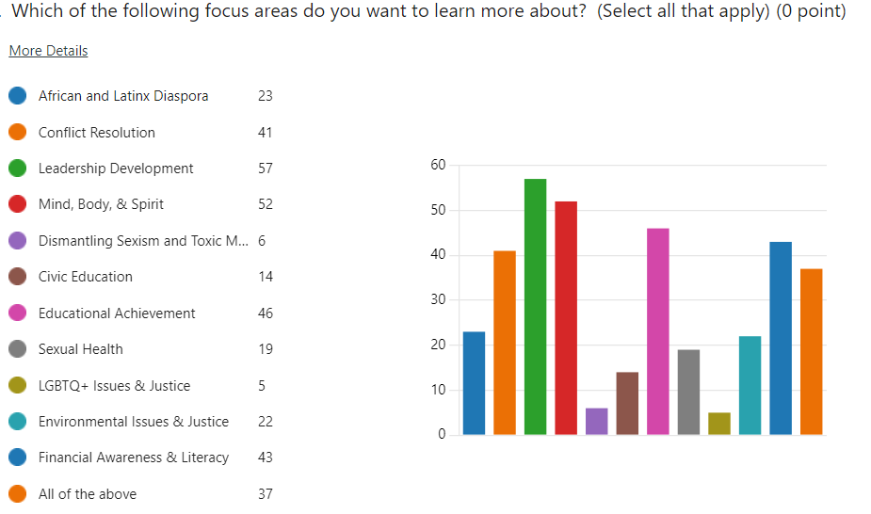
Data | Student Priorities
While in this club, I hope to learn more about the world and how I fit in the world as a man of color.
I’d like to get out of my comfort zone and basically distract my mind with something productive, instead of being on a device.

Slide 18
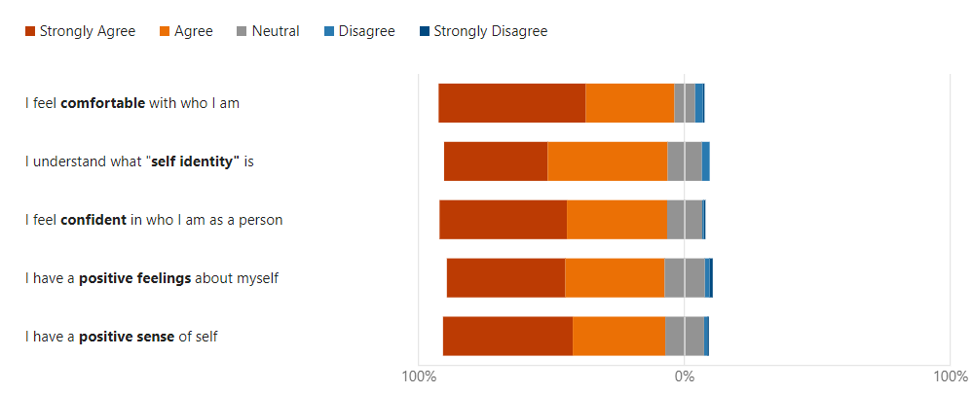
Data | Student Identity Perceptions

Slide 19
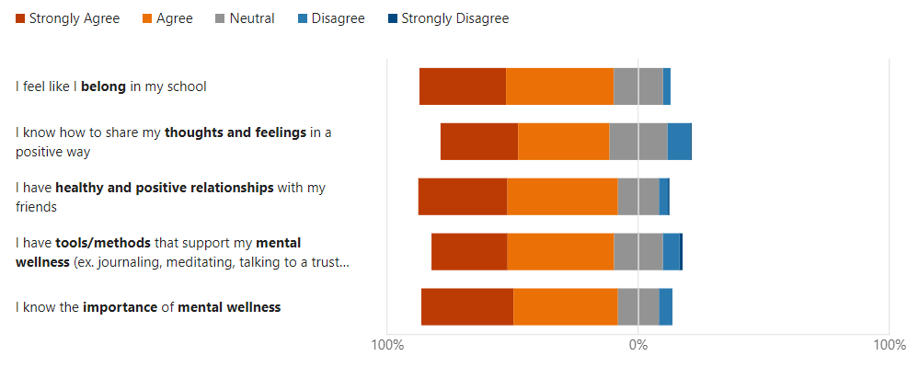
Data | Student Wellness Perceptions

Slide 20
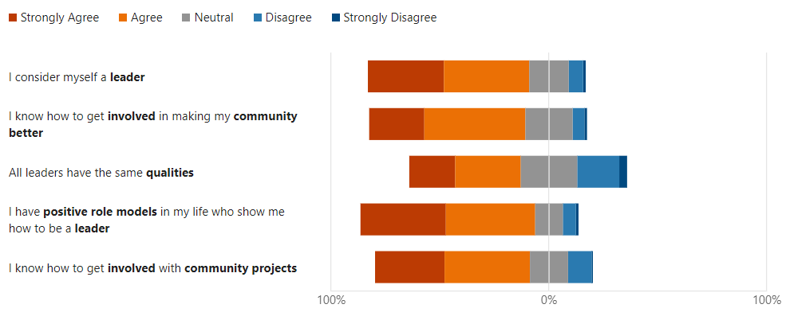
Data | Student Leadership Perceptions

Slide 21
EMOC’s Curriculum
Bonding and Community Building | Critical Thinking Knowledge of Self and Global Awareness | Oath of Dedication
Who Are We Gonna Be? Conflict Resolution 101 Auto Biographies: Build Your Book What Does “Defund the Police” Mean? Know Your Rights Economics 101 Activism in Sports: Colin Kaepernick Drugs and their Effects My Brother Is? Creating a Mission Statement What is a Brother Leader? | World History 101 What is Consent? 101 Life Aboard a Slave Ship Mass Incarceration and Inner City Violence The War on Drugs Capitol Hill: The Riots of January 6th BHM: What I wasn’t taught in school What are Your Priorities? Intro to Time Management Life Maps | Toxic Masculinity Sexual Education 102 Tear It All Down: Intro to Sexism and Misogyny Echoing Baldwin Member Self-Assessment Etiquette: Code Switching 101 Agency/Mock Interview Apathy vs. Activism The 5-Year Plan The History of Looting in America Oath of Dedication Ceremony

Slide 22
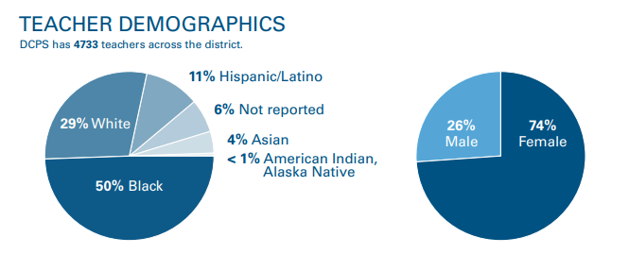
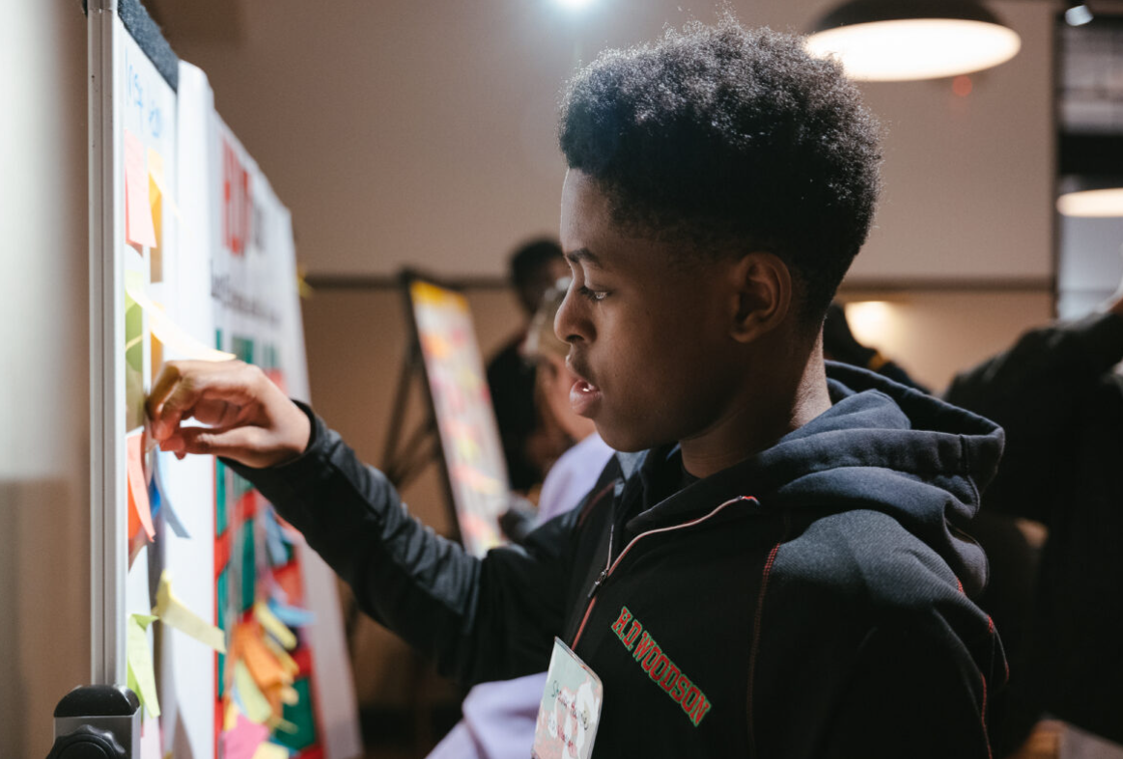
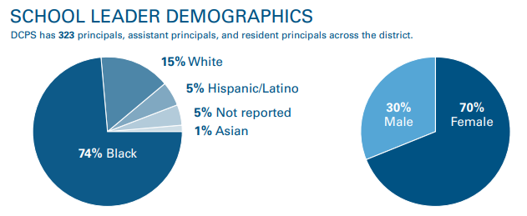
Educator Demographics

Slide 23
MEOCC | Male Educators of Color Collaborative
The Male Educators of Color Collaborative aims to be a sustainable cohort of DCPS educators that create spaces for fellowship, development, and growth for Black and Brown male educators in DCPS.​
​
Through MEOCC, members will have the opportunity to connect with fellow DCPS Black and Brown male educators to build and empower our brotherhood.
Mentoring: Our priority is to intentionally support connections between educators at different stages of their career
Relevant Professional Development: We provide opportunities for male educators to learn about topics they are interested in (e.g., Practicing Gratitude in Times of Uncertainty, and Navigating with Emotional Intelligence: Building Your Village).

Slide 24

What is Antiracist Educator University?
Antiracist Educator University (ARE-U) is a professional learning experience designed to build a community of antiracist champions across District of Columbia Public Schools (DCPS). ARE-U provides educators with opportunities to engage in shared learning, build their capacity for antiracist leadership, and support school and district efforts to improve the educational experiences of all students of color.
Our Vision
An empowered community of ARE-U champions who, through their continuous learning and commitment, create an environment in which we eliminate opportunity gaps, interrupt institutional bias, and remove barriers to academic and social success, particularly for students of color.
Our Mission
ARE-U creates an influential community of antiracist champions across DCPS through an engaging curriculum where participants learn about antiracist and intersectional concepts and aligned educational practices, apply learning with the support of Professional Learning Communities, and showcase knowledge and skills by earning micro-credentials.
Notes:
Joy
So, what is Antiracist Educator University?
Antiracist Educator University (ARE-U) is a professional learning experience designed to build a community of antiracist champions across District of Columbia Public Schools (DCPS). ARE-U provides educators with opportunities to engage in shared learning, build their capacity for antiracist leadership, and support school and district efforts to improve the educational experiences of all students of color.
Send up a heart if you have participated in ARE-U before.
For those of you who have participated with ARE-U previously, you know that our programming has evolved every year since its inception in 2020. I am so impressed with how far we’ve come, and so excited with how far we have the potential to go!

Slide 25
From the News: Math Proficiency Rates Plummeted, Achievement Gap Widened in D.C. Schools During Pandemic
“…Across all grades, math proficiency rates plummeted. 60 percent of students scored level one or two on the PARCC assessment – a sizeable decrease from 2019…
…The results show that learning loss was most acute among the city’s low-income and non-white students …an outcome that mirrors most reverberations of the pandemic, where individuals already marginalized or at-risk bore the brunt of its impacts…
…In math, proficiency rates dropped by 12% for Black students and 13% for Hispanic Latino students, compared to 8.7% for white students…”
From dcist: September 2, 2022
Notes:
Robyn
Dionne gave an incredible plenary keynote this morning about the equity imperative for culturally responsive and rigorous math education. However, we know that the first Condition for having a courageous CONVERSATION about race is to make it personal, local, and immediate.
I pulled an excerpt from an online news source. It talks about how our math proficiency rates plummeted and the achievement gap widened for students of color after the pandemic. I’ll just read what’s in bold.
*Ask questions on screen

Slide 26
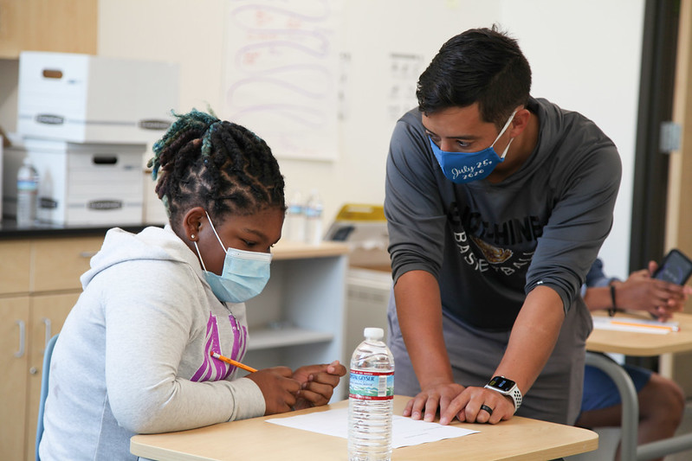
ARE-U 120: Antiracist & Culturally Affirming Math Education
ARE-U 120:
Antiracist & Culturally Affirming Math Ed.
Understanding Math Inequities Using Data
Educator Math Identity & Experiences
BIPOC Student Math Experiences in DCPS
Mitigating Bias & Stereotype Threat in Math Education
Delivery Format: Virtual (Live) Facilitation
Course Description: This course is designed to support participants in reflecting and interrogating their own mindset, biases, and practices related to math education. They will analyze and interpret racialized trends in student math opportunities and performance. Participants will also be introduced to antiracist and culturally-affirming practices to mitigate the impact of bias and stereotype threat on student math outcomes.

Slide 27
ARE-U 120: Antiracist & Culturally Affirming Math Education
Session 1: Understanding Math Inequities Using Data
Session 2: Educator Math Identity & Experiences
Session 3: BIPOC Student Math Experiences
Session 4: Mitigating Bias & Stereotype Threat in Math Education
Participants will explore how implicit bias and stereotype threat impact the engagement and performance of students in math education. They will learn how to support BIPOC students in developing positive math identity using culturally affirming and asset-based communication.
Participants will deepen their Courageous Conversation by continuing with Conditions 4-6. Specifically, they will connect their personal reflections and student math data findings to broader historic and current educational contexts and inequities impacting DCPS student math performance. Participants will also learn how they can support the DCPS DREAM in eliminating institutional bias and opportunity gaps.
Participants will reflect on the intersection of their racial identity and “math identity,” including their personal experiences with math in and out of school. They will engage in a discussion using the Courageous Conversations Protocol (Conditions 1-3) and become more aware of the diversity of educator perspectives related to math and how personal experiences can influence professional practice.
Participants will explore district-level data related to student math course enrollment and performance, focusing on trends in racialized student experiences. They will learn a protocol for Using Data to Guide Difficult Questions around Structural Racism using examples from frequently used sources (e.g., MTSS, PARCC) to leverage during weekly data meetings and BOY, EOY, MOY data step-backs.

Slide 28
Self Reflection Activity: Linked are self-reflection questions developed using the NCTM’s 8 Effective Teaching Practices. Answer the survey questions based on how well you believe you currently exemplify these antiracist math practices.
Self-Reflection Questions Aligned to the NCTM’s 8 Effective Teaching Practices:
How consistently do you hold BIPOC students to high expectations?
How often you create opportunities for BIPOC students to practice “higher-order thinking” skills?
Do you acknowledge when BIPOC students apply mathematical thinking to contexts that interest them?
How meaningful and relevant is the math-related discourse in your classroom?
Have you interrogated the purpose of the questions you ask BIPOC students?
How often do you use representations that draw on the knowledge, experiences, and culture of BIPOC students?
How do you encourage and support BIPOC students struggling with math? For how long?
How do you affirm positive math identities in BIPOC students?
Source: Using Data to Guide Difficult Conversations around Structural Racism
Notes:
(15 min.) Facilitator says:
Let’s take some time to self-reflect on how well you believe you are currently exemplifying these practices. Think of this as not only an opportunity for you to self-identify opportunities for professional learning and growth, but also an opportunity for you to provide specific feedback to the district about how they should invest in supporting us.
Use the link or QR code to access a survey to complete your self reflection as I read through the questions. [Read the question and pause for participants to answer as you go]. (Note: the survey completion will also be used as evidence of your facilitation for stipend processing purposes.)
After everyone completes their survey, ask: Does anyone want to share any anything that they learned about themselves as a result of this activity?
Survey Link: https://forms.office.com/Pages/ResponsePage.aspx?id=7kagKk6zM0qSt5md8rwKMgQHFBZgtGJLhmec_qllYYpURTZVSVlQUUNaT09RTUJHSlM0VE1ISEFMMyQlQCN0PWcu

Slide 29
Agenda
Opener
Where We’ve Been
  DCPS Historical Racial Equity Timeline/Journey
Where We Are Now
  Student Data
  EMOC Programming
  MEOCC Programming
  ARE-U Programming
Questions and Discussion

Slide 30
Questions and Discussion
Programmatic:
  What bright spots or gaps do you see in our current programming?
  How have you addressed concerns families may have about safety with afterschool programming or experiential learning opportunities for students?
  Given competing district priorities and concerns about educator burnout, how are you recruiting effective facilitators for student programming?
Systemic:
  What levers within our system should we pay more attention to if our goal is to advance the achievement of our Black and Latino young men and boys?
  How have you leveraged a broader citywide ecosystem to support similar initiatives?

Slide 31
DCPS Racial Equity Action Vision Statement
*due to Office of Racial Equity 2/10/23
The District of Columbia Public Schools (DCPS) acknowledges the existence of numerous, varied inequities in some of the laws and policies of Washington, DC, and their impact on our schools, students, and mission. These inequities are born from the legacies of discrimination, segregation, economic and educational disenfranchisement, redlining, displacement, and the enslavement of Black people. The District’s most historically excluded and economically vulnerable residents, often people of color and those experiencing systemic poverty, too often experience the negative effects of a lack of access to resources. These negative effects prevent communities, particularly those east of the Anacostia River, from having full access to equitable opportunities.
DCPS is committed to becoming a whole child, anti-racist school district. We believe in fostering an environment in which we eliminate opportunity gaps, interrupt institutional bias, and remove barriers to academic and social success, particularly for students of color. We provide access, inclusion, and affirmation and offer the most support where the greatest disparities have persisted to promote racial equity. We honor our commitment by affirming our students’ cultures and communities, incorporating social-emotional learning and culturally responsive practices, increasing access to rigorous academic content and financial resources, and changing policies to promote equity and remove barriers.
It is the vision of DCPS that every student feels loved, challenged, and prepared to positively influence society and thrive in life. We recognize there are both individual and collective dimensions to this work, as well as a simultaneous focus on people and systems. We further commit to our vision of advancing racial equity by naming and addressing inequities when we encounter them, creating transparent processes that are accessible to all, elevating the voices of those furthest from opportunity, and holding ourselves accountable for the impact of our work.
Equity is bolstered by our core DCPS values of students first, excellence, teamwork, courage, and joy. DCPS will achieve our commitment when we eliminate racial gaps in achievement, discipline, and the experiences of students, irrespective of identity or location of district residence.

